Slide 1
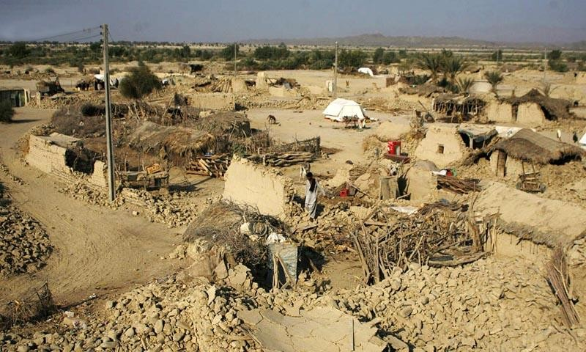
HOUSING & POST-EARTHQUAKE RECONSTRUCTION IN AWARAN
presentation

Slide 2

Chief Minister Punjab’s Sponsorship for Awaran Total Cost. Rs.487.7 Million
Internship Program for 550 unemployed graduates of
Improvement of Health Facilities at DHQ Hospital Awaran
Cost= Rs. 85.00 Million
Construction of park at Awaran (Rs.6.7 Million)
Awaran for three years (Started From Feb 2016)
Cost= Rs.396 Million
550 Graduates of Awaran and UC
Dandar (Kech) appointed and posted at schools & hospitals for their skill development, and for pursuing further study
Incentive for specialist doctors
Construction of Residential building
Renovation of DHQ hospital building
provision of ambulance ,vehicles and medical equipment
A Family park with a walking track was constructed Infront of District Headquarter Hospital Awaran

Slide 3
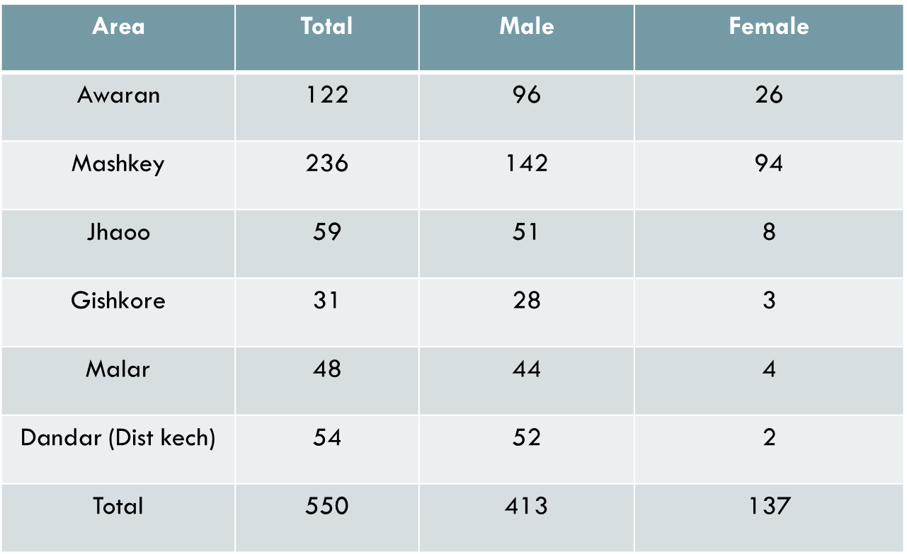
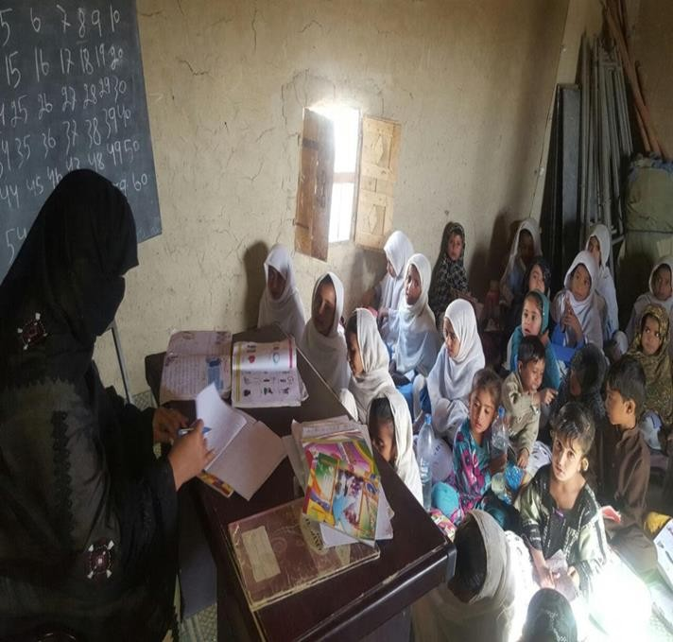
Internship Program for 550 unemployed graduates of Awaran for three years (Rs.396 Million)

Slide 4
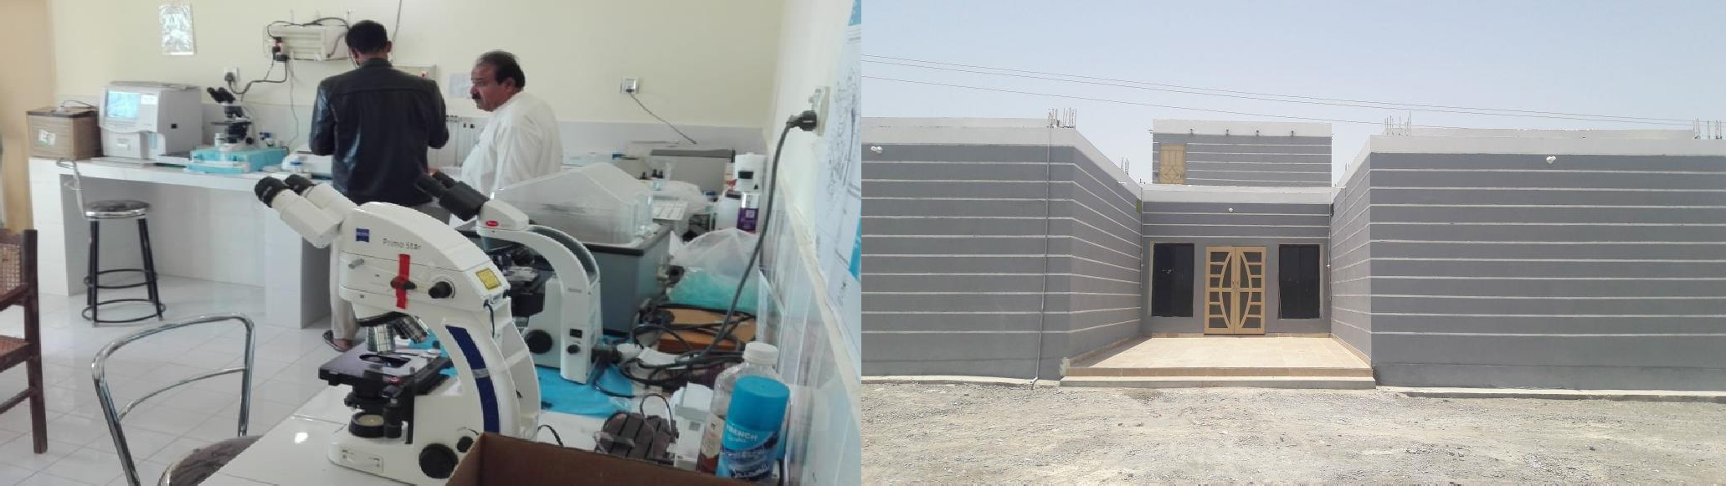
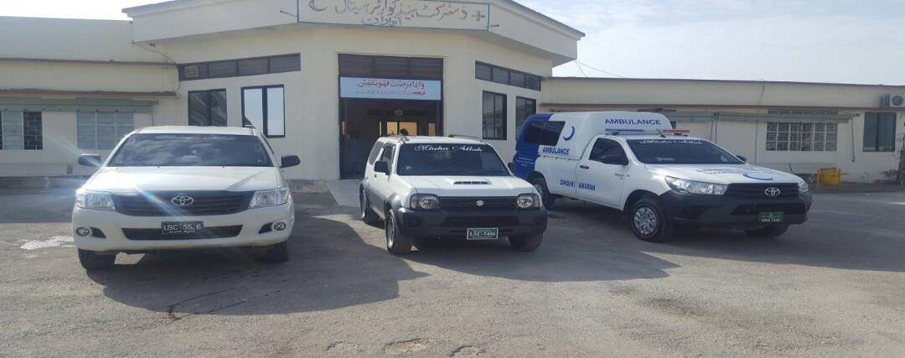
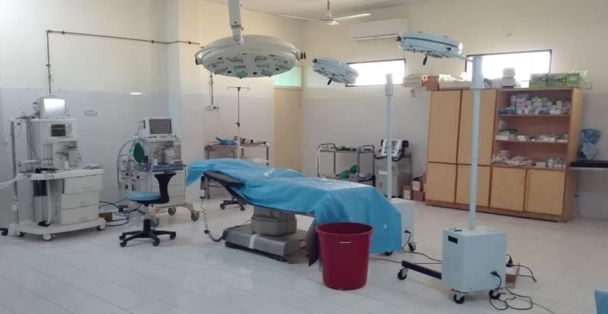
Improvement of Health
Facilities at DHQ Hospital Awaran (Rs. 85.00 Million)
Incentive for specialist doctors, Construction of residential building, Renovation of DHQ hospital building and provision of ambulance ,vehicles and medical equipment

Slide 5
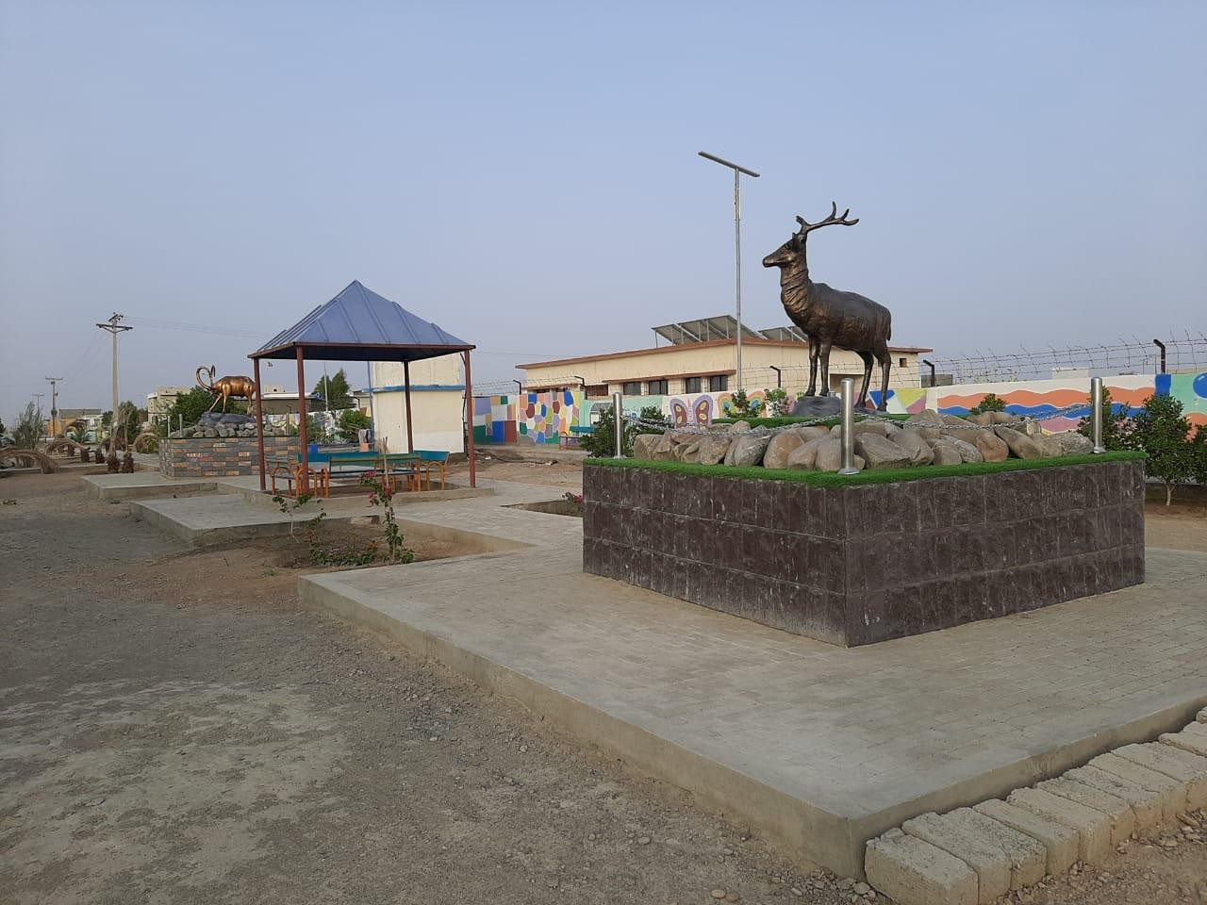
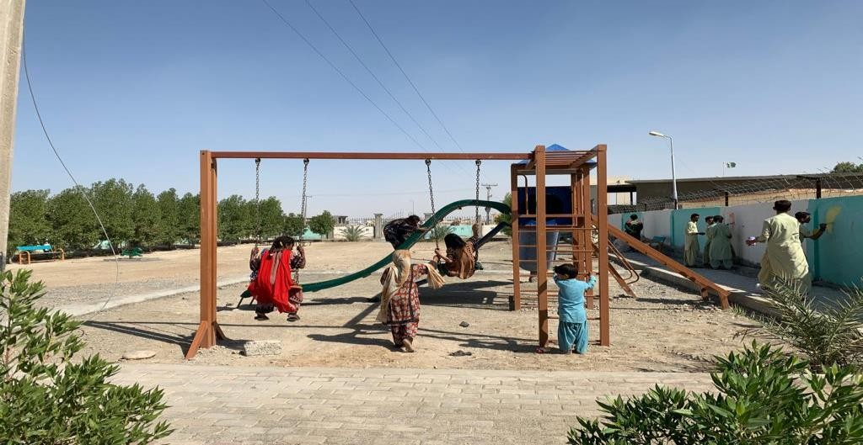
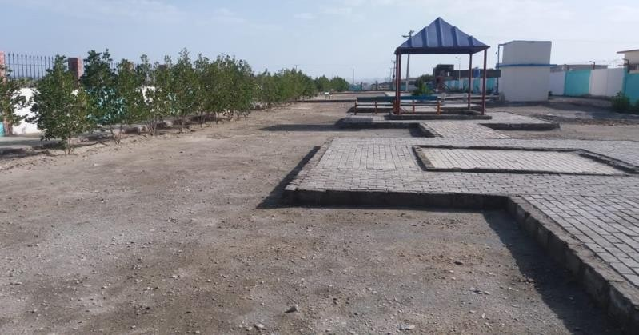
Construction of park at Awaran (Rs.6.7 Million)
HRA Park at DHQ Hospital Awaran

